Slide 1



Slide 2
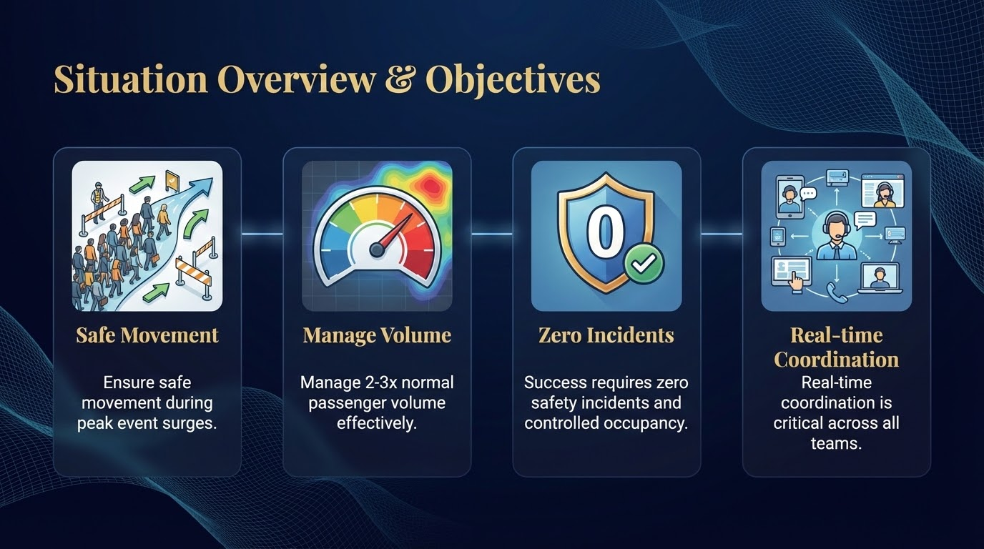

Slide 3
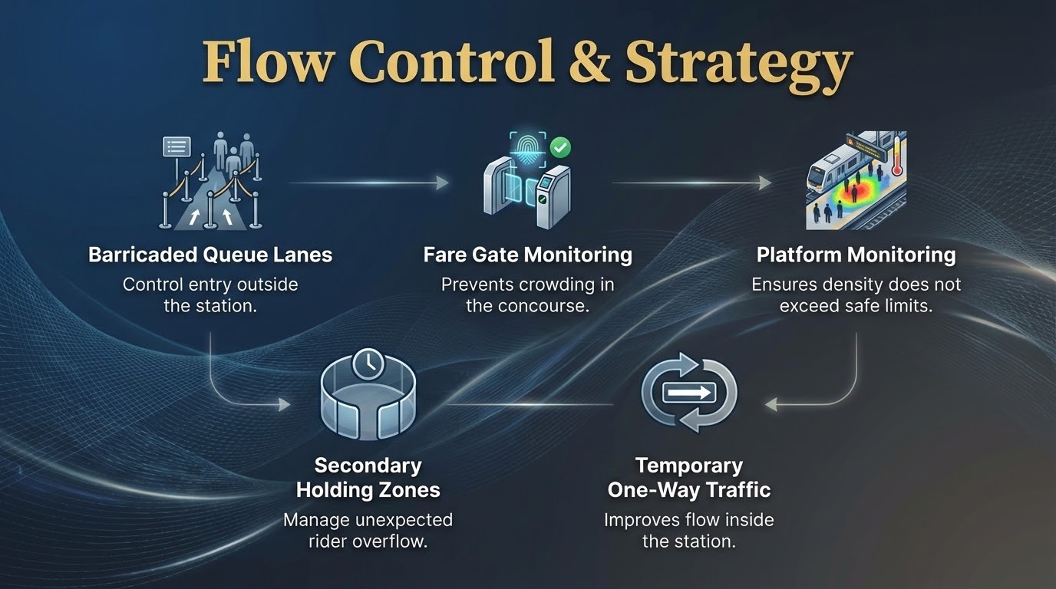

Slide 4
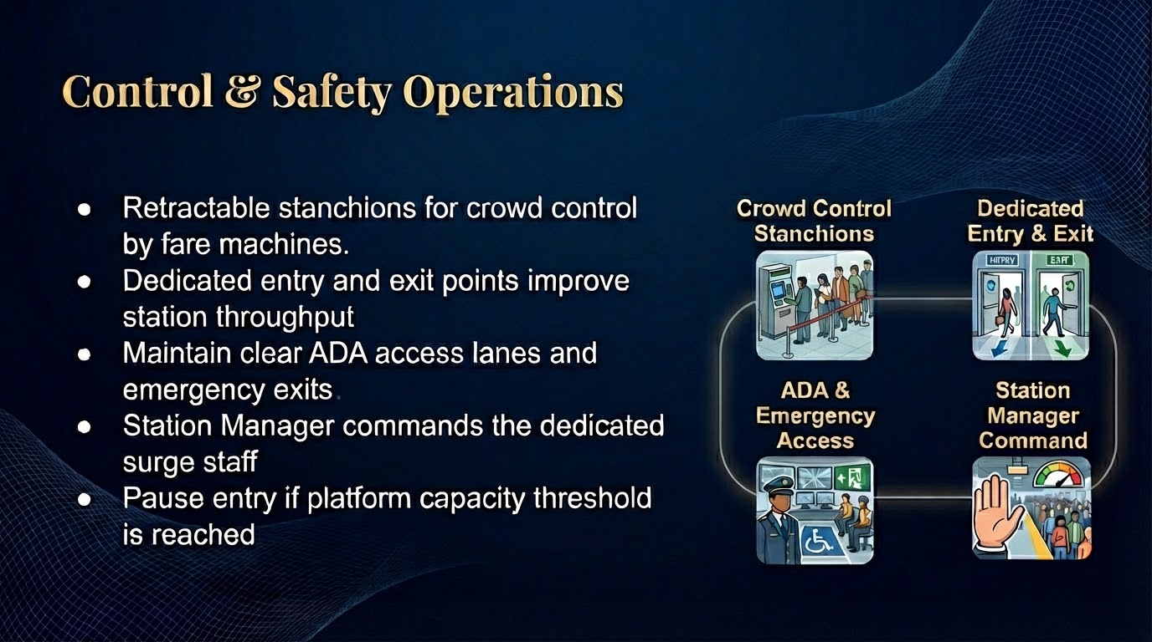
Notes:
Staffing Deployment
Station Manager (Command Lead)
4–6 Fare Control Officers
4 Platform Attendants
2 Crowd Flow Monitors (outside)
2 MARTA Police Officers
EMS standby coordination

Slide 5
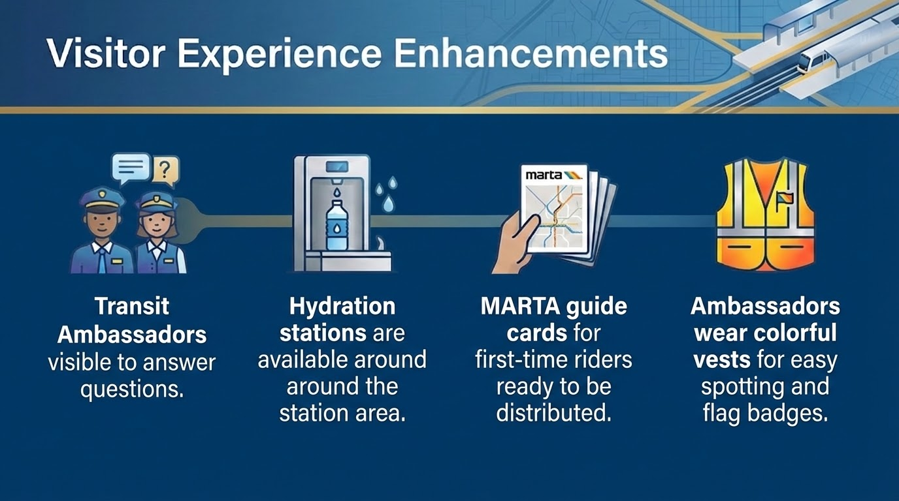

Slide 6

Thank you!

